Slide 1


Big Data Strategy
Yelp review
0503 Team G: Yifan Dang, Zongdi Zhou, Dixi Lin, Qihan Hu

Slide 2
Data Information and Analysis Tool
Data Set: yelp_academic_dataset_review.csv (4GB)
(rows:5996996, columns:9)
yelp_academic_dataset_business.csv(163MB)
(row:188593)
Information includes: “business_id”, “cool”, “date”, “funny”, “review_id”, “starts”, “text”, “useful”, “user_id” and “categories”
Tools: Hadoop(virtual Machine, AWS), R, Python, Pig, Spark, Tableau
2

Slide 3
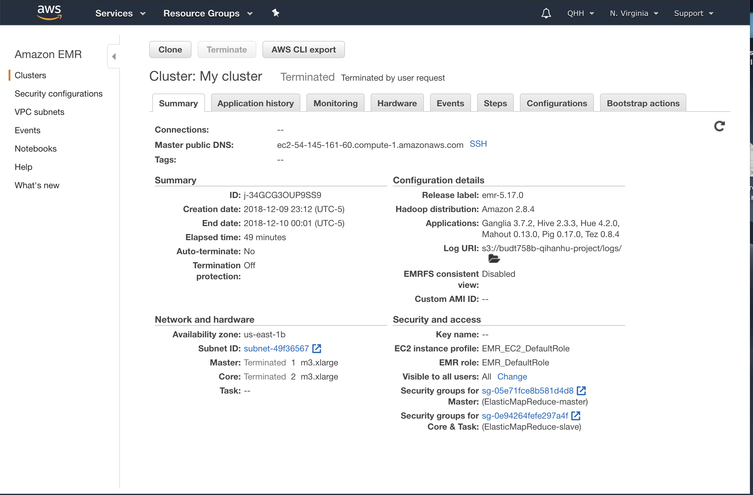
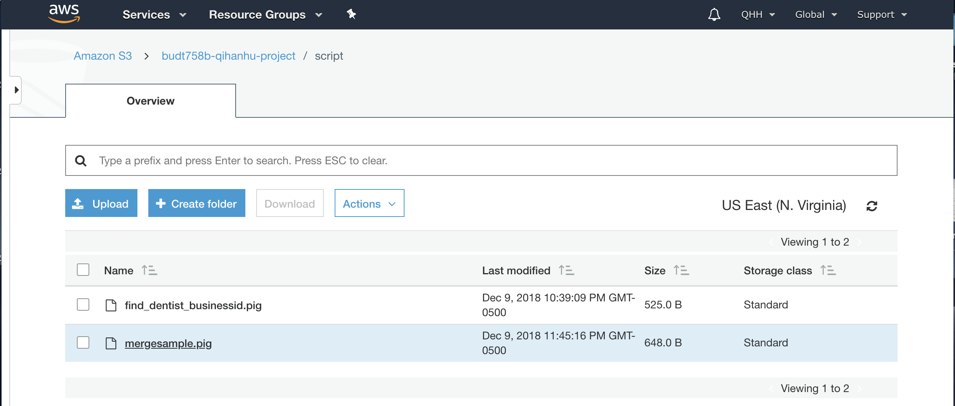
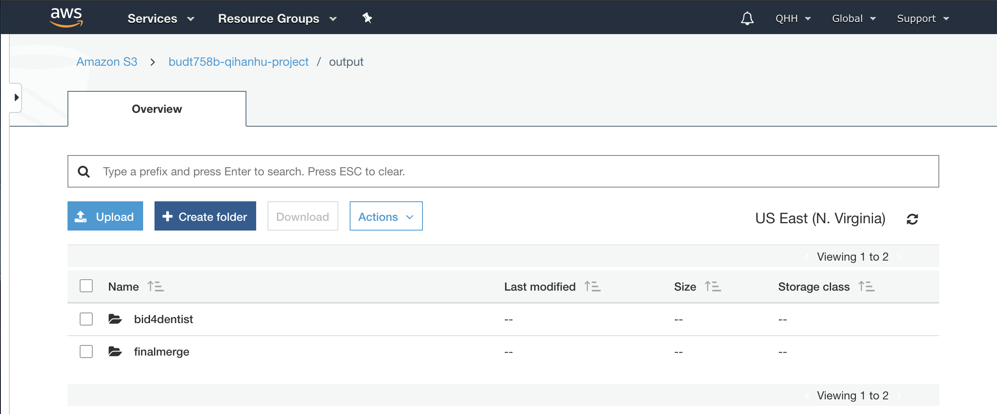
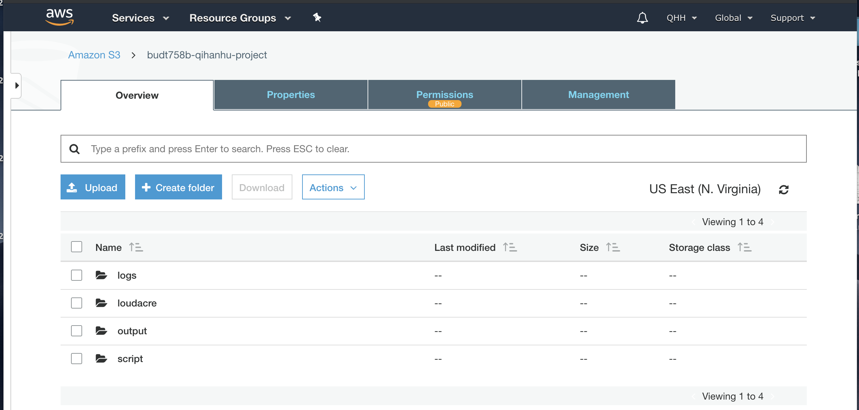
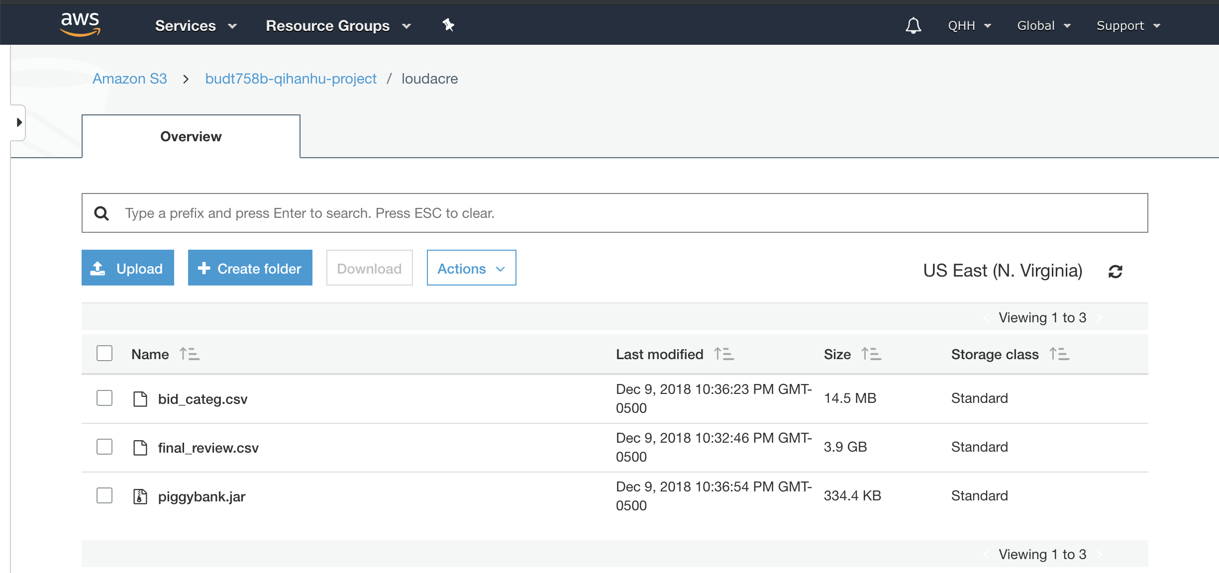
Data storage strategy
Cluster configuration, location, use of a database or text files
3

Slide 4
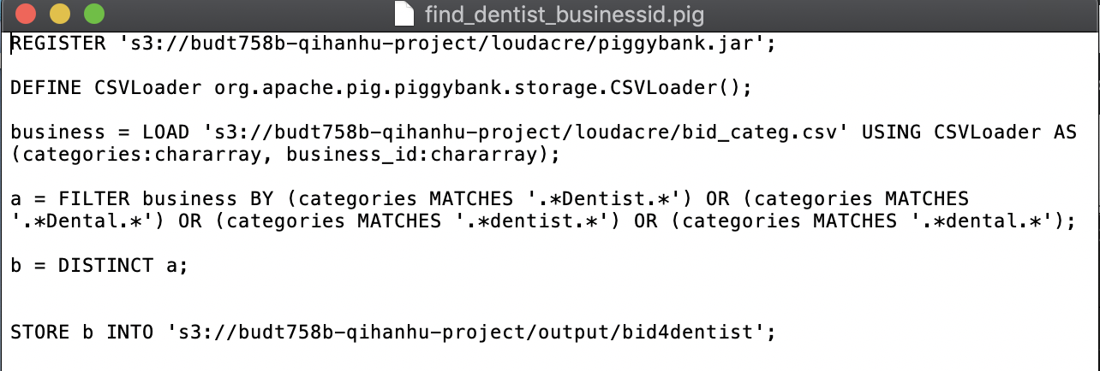
DATA queries
Pig Script that pulls out all the dentists’ “business_id” that matches the “categories” being “dentist” and “dental”.
4

Slide 5
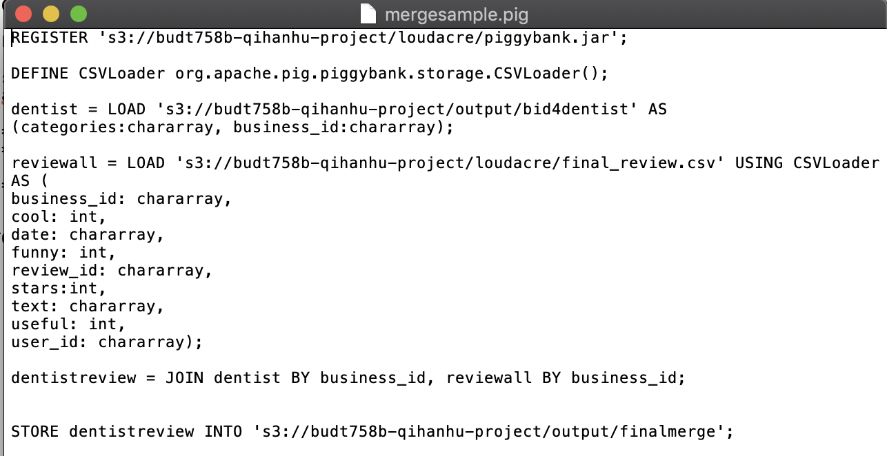
DATA queries Cont.
Pig Script that uses all dentists’ “business_id” that pulled from previous step, then matches against “final_review.csv” where contains all the review information including “business_id”, “cool”, “date”, “funny”, “review_id”, “starts”, “text”, “useful” and “user_id”.

Slide 6
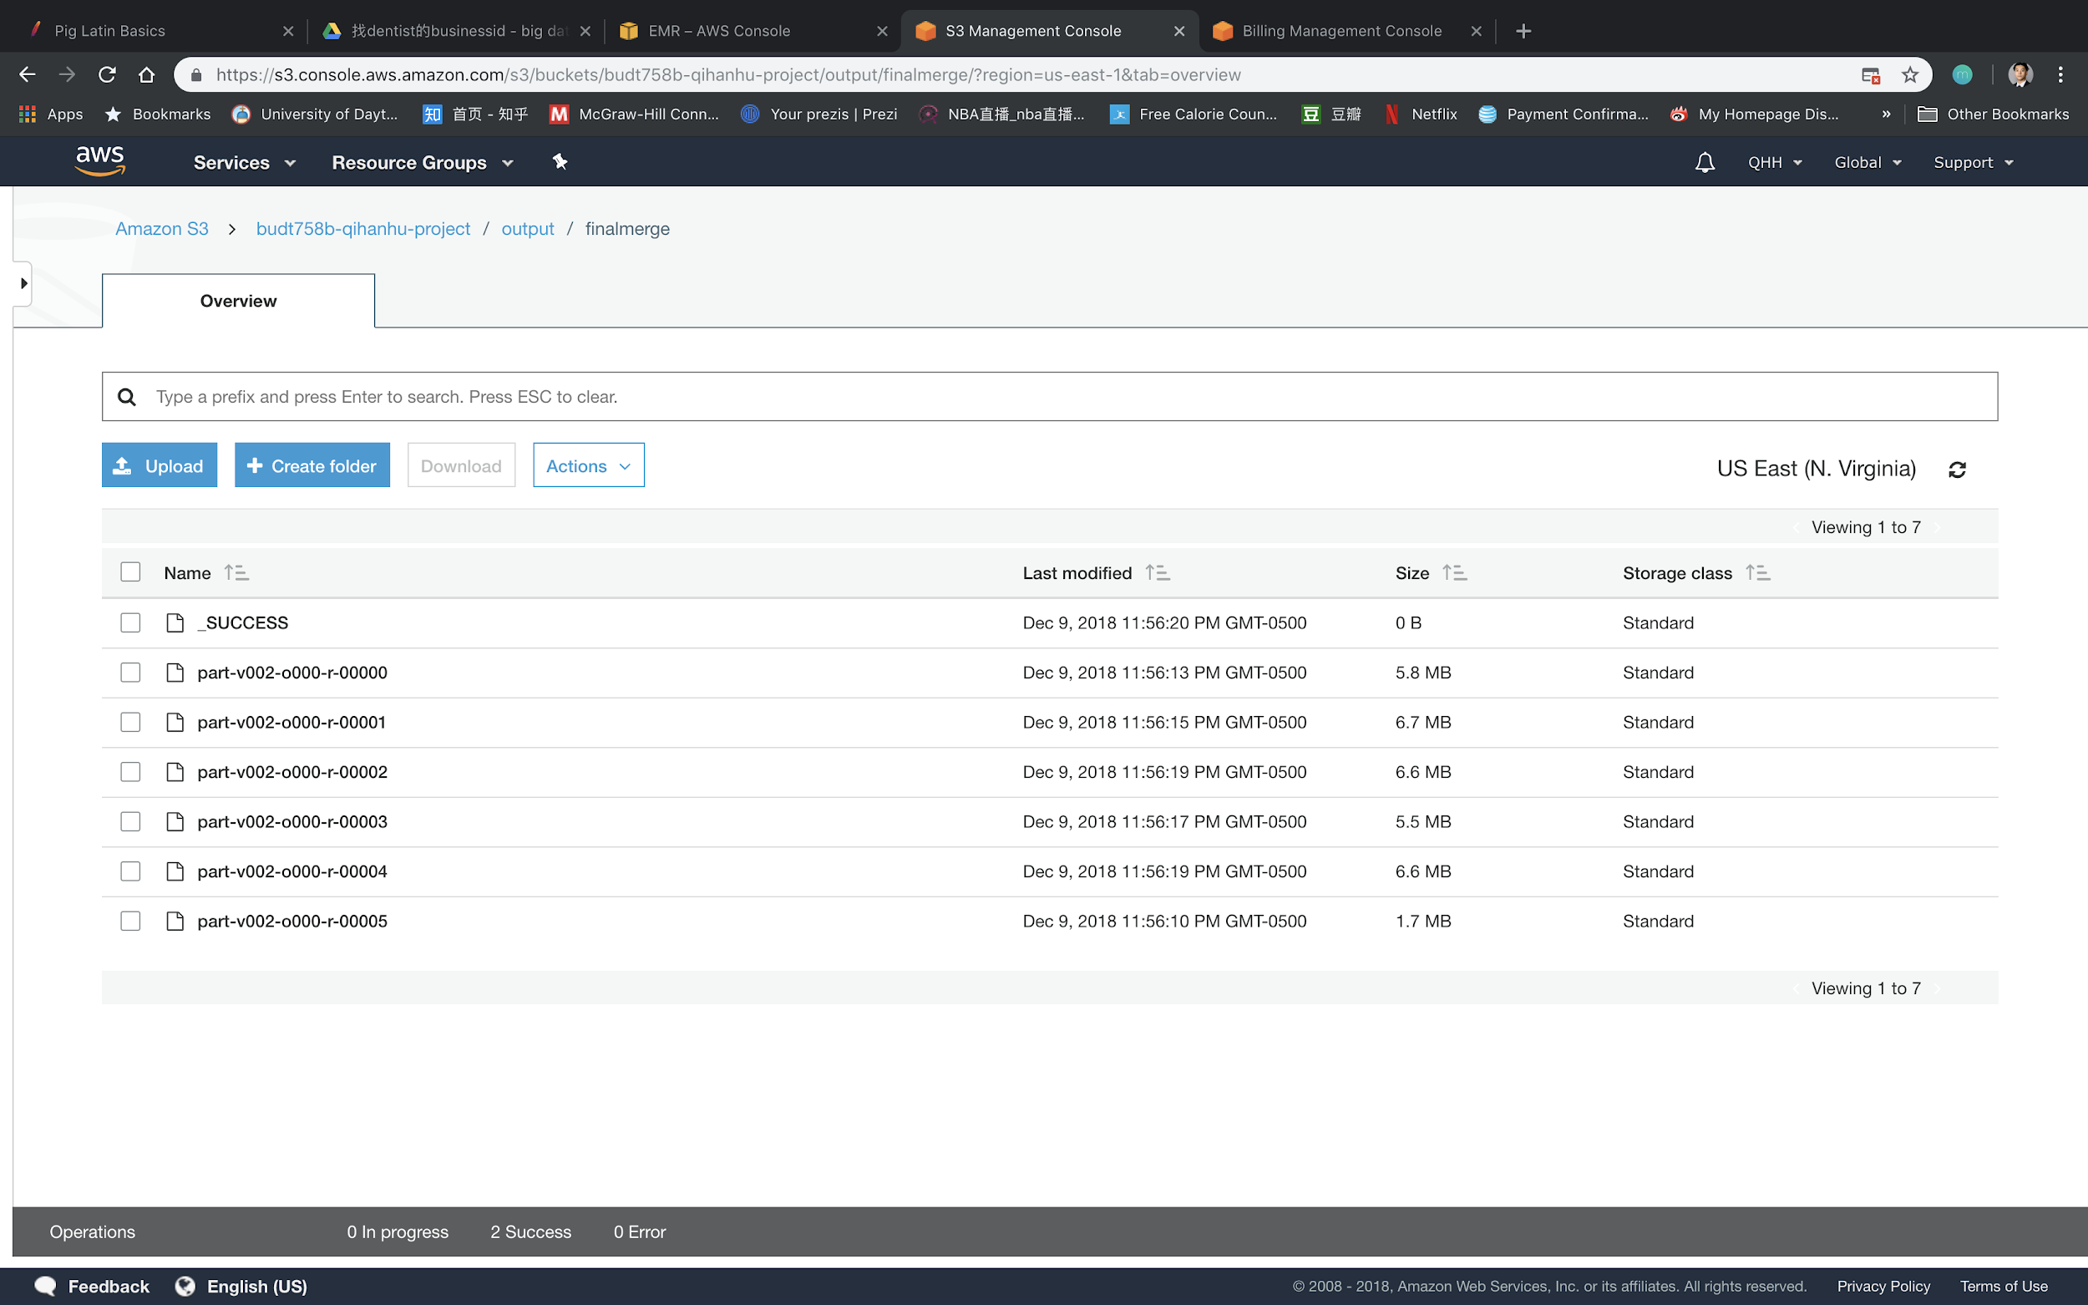
DATA queries Cont.
MapReduce results in AWS.

Slide 7
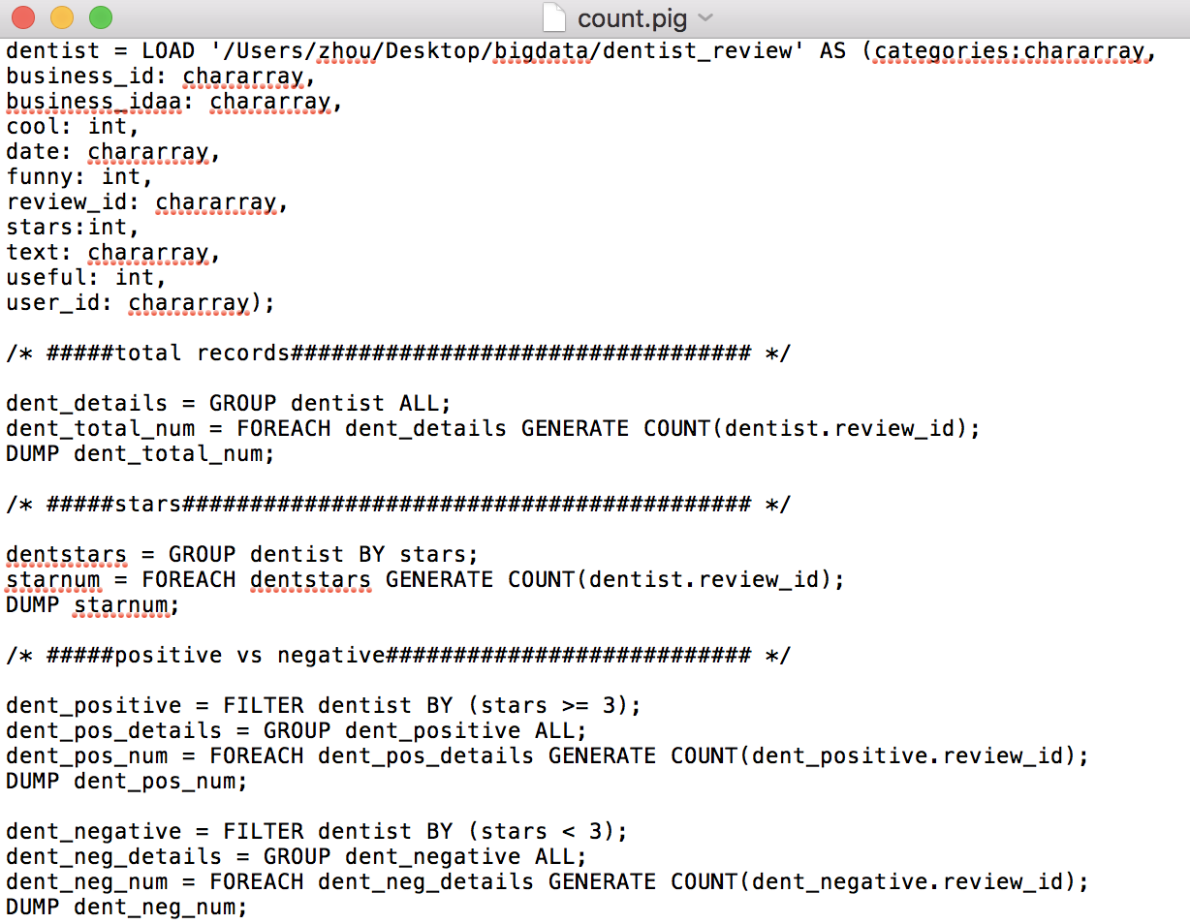
Descriptive Queries
Totally data set after join is 32.8 MB, and we have 44366 dentist reviews, of which 7036 reviews give one star, 1165 reviews give two stars, 651 reviews give three stars, 1658 reviews give four stars and 33856 reviews give five stars.
To sum up, there are 36165 positive reviews and 8201 negative reviews.

Slide 8
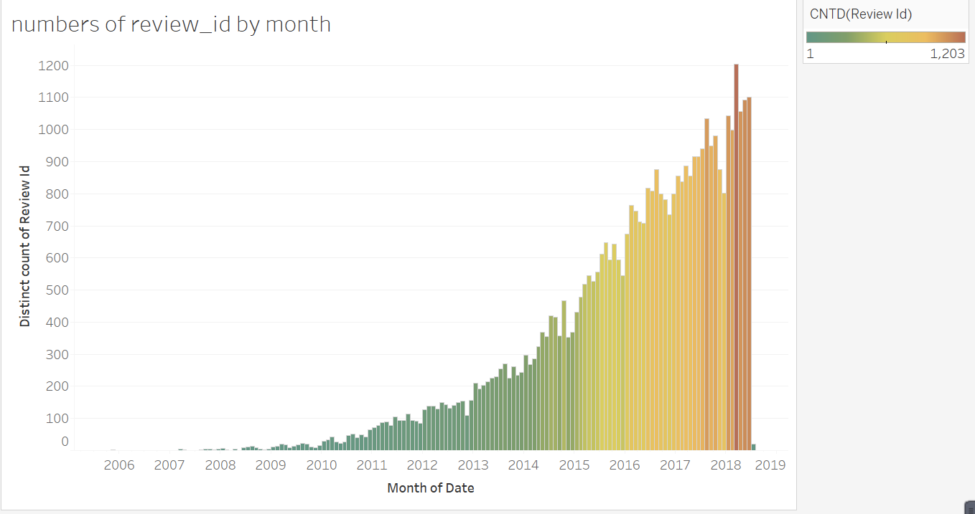
Reviews Trending

Slide 9
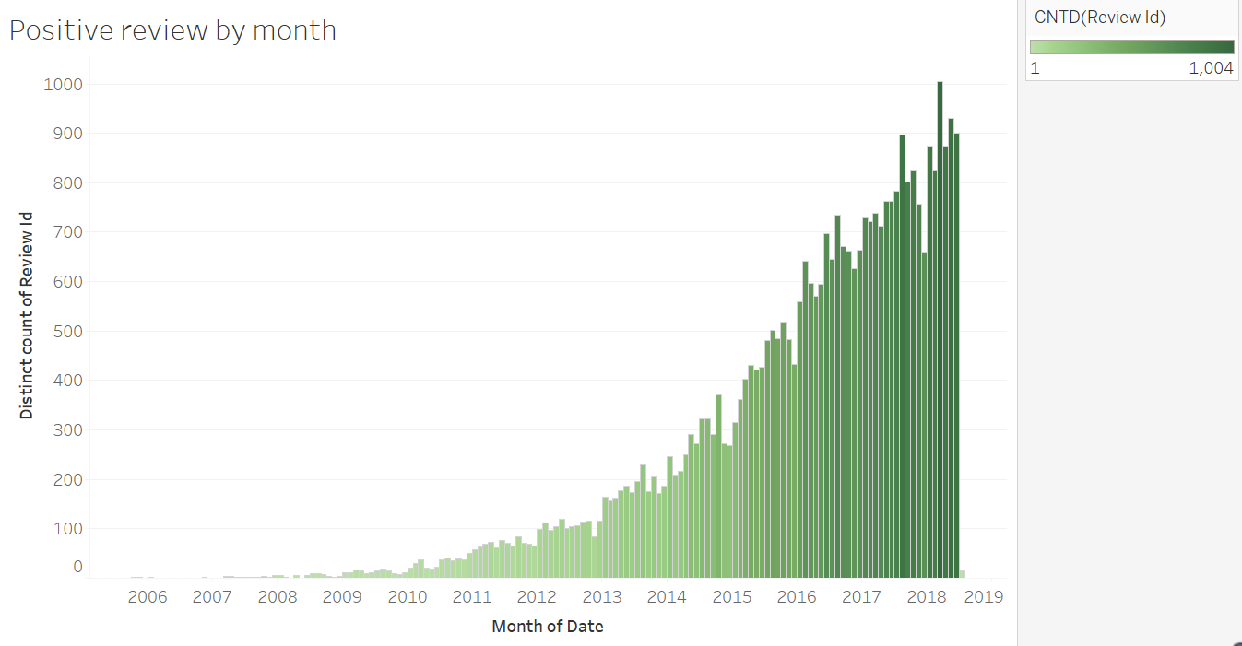
Positive Reviews Trending

Slide 10
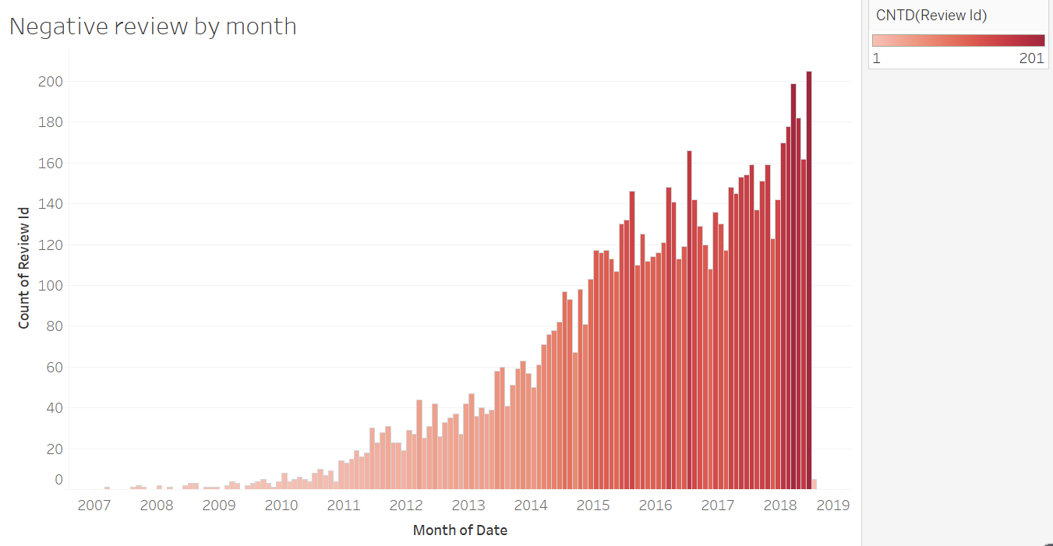
Negative Reviews Trending

Slide 11
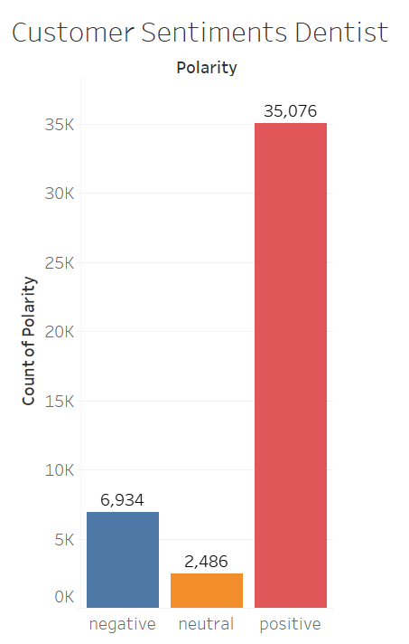
Sentiment Analysis
6

Slide 12
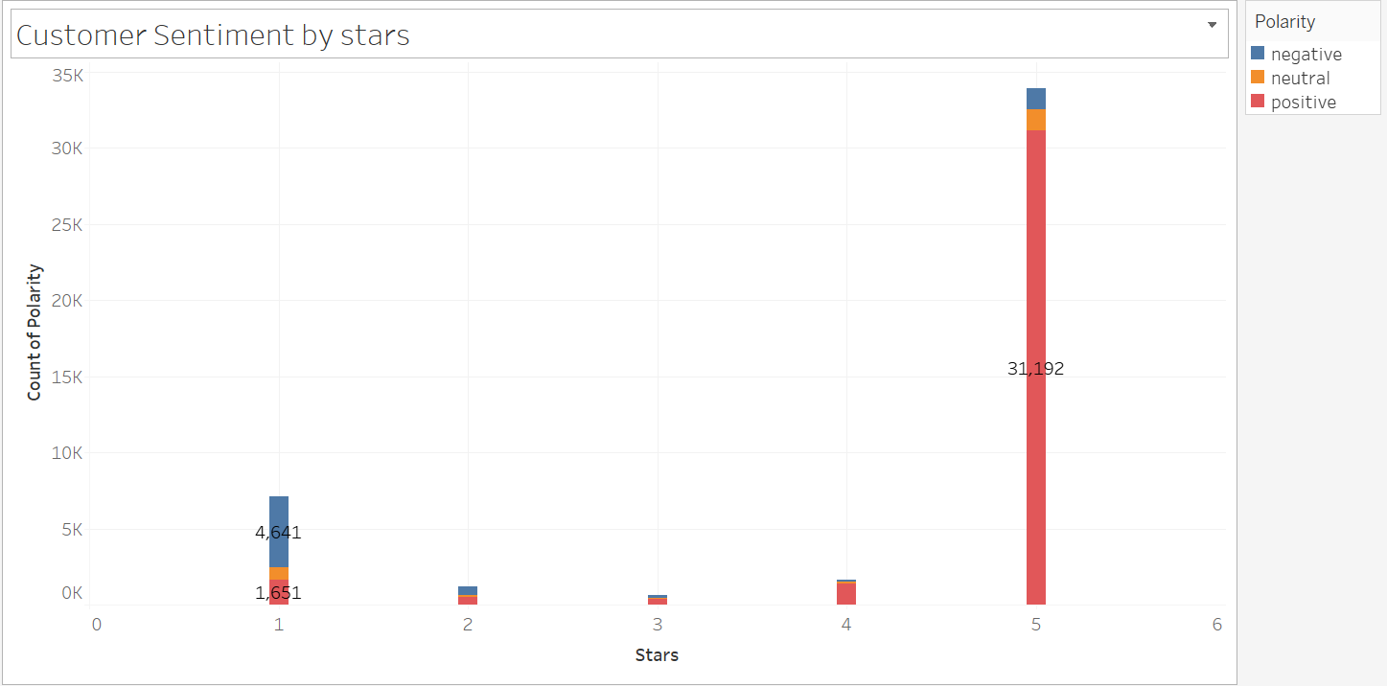

Star 1 and Star 2 has relative higher negative review
Star 3,4 has relative more positive review
Star 5 has a significant positive reviews
Generally, the higher the rank, the more the positive review.

Slide 13
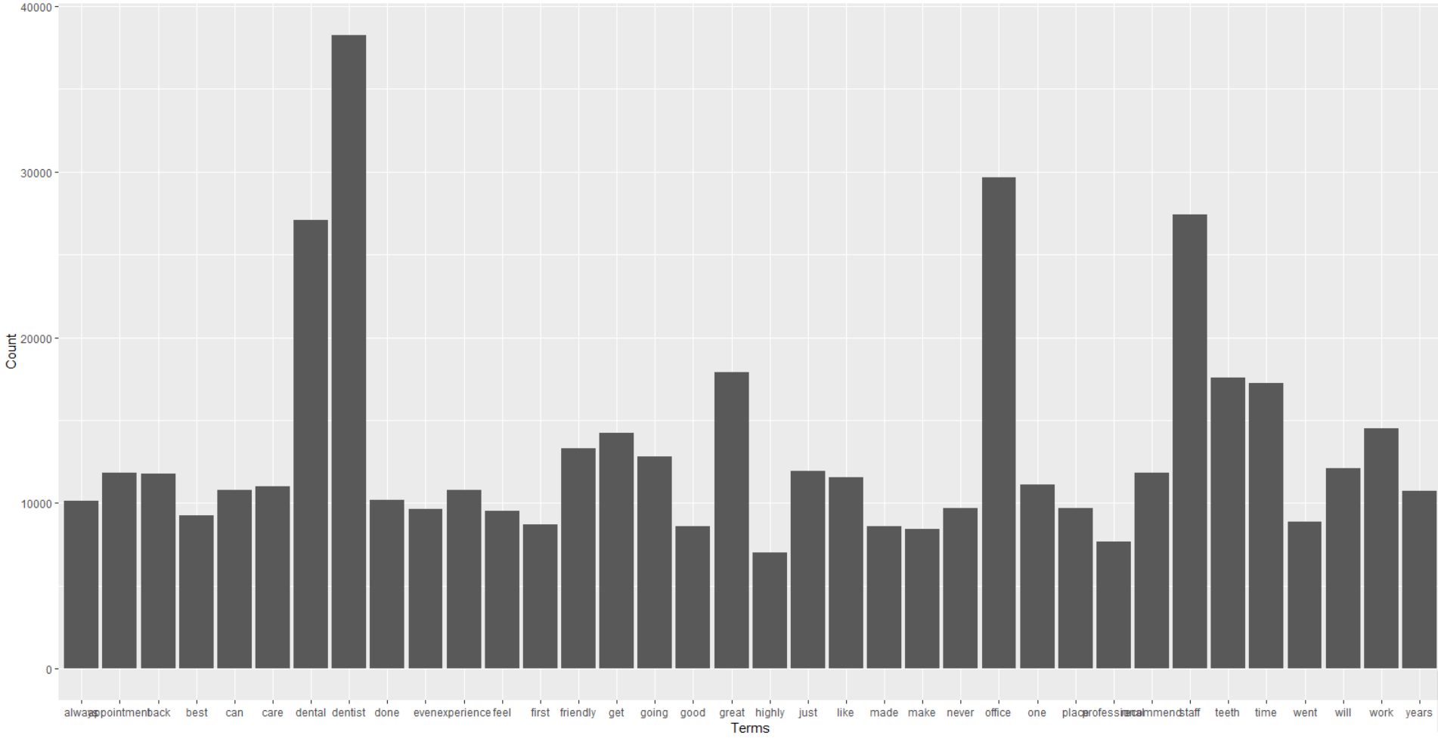
Analytic Models
Text Mining
Term Document Matrix (TDM)
Convert all text contents to lowercase
Remove Sparse Terms( in fewer than 10% of documents)
Remove Stopwords(e.g. “the”, “of”, “and”, “to”...)
RemoveNumbers
Stem the words (e.g. users--user, acting--act)
Strip Whitespace
weight the term-document matrix by term frequency.
5

Slide 14
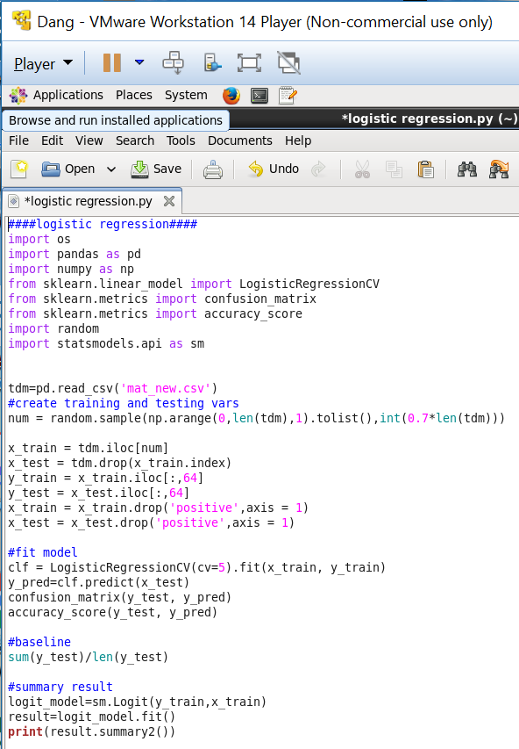
Prediction Model
Data Set: Term Document Matrix (TDM)
Prediction model: Logistic Regression
Prediction Tools: PySpark
Classified negative: star 1,2
Classified positive: star 3,4,5
Predicted binary outcome: positive (1), Negative (0)

Slide 15
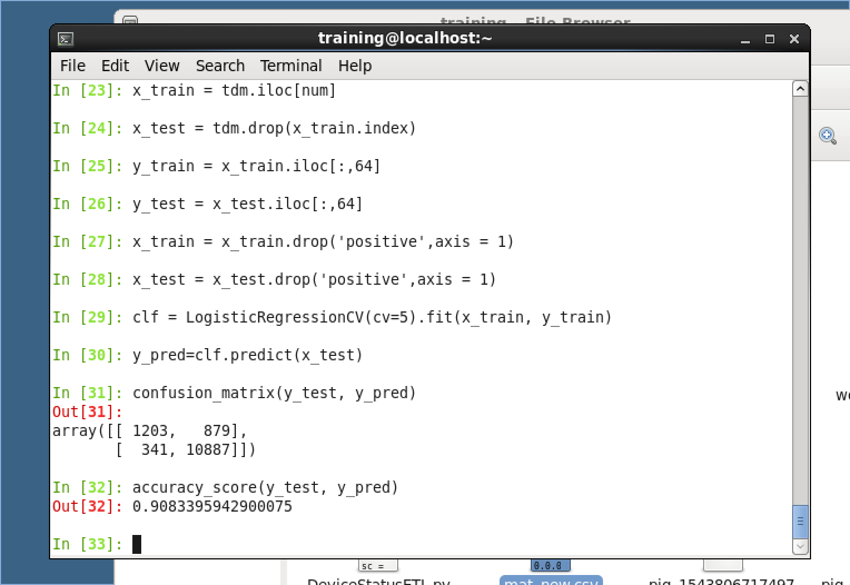
Prediction Model
Random splitting the training data 70%
testing data 30%.
Cross Validation: 5-folds in the training data set t avoid overfitting
Testing data prediction accuracy: 0.9083
Baseline:0.8436
Model is fairly robust
Random Forest model: 0.90104

Slide 16
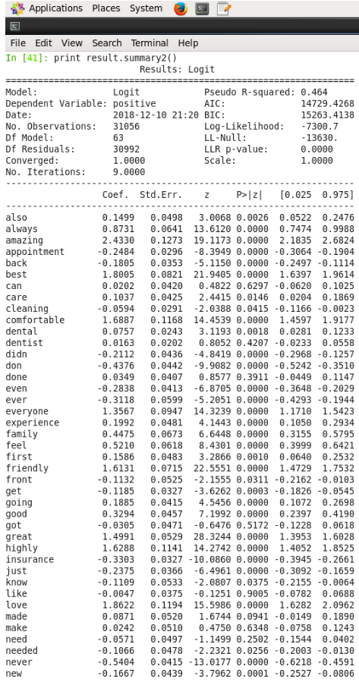
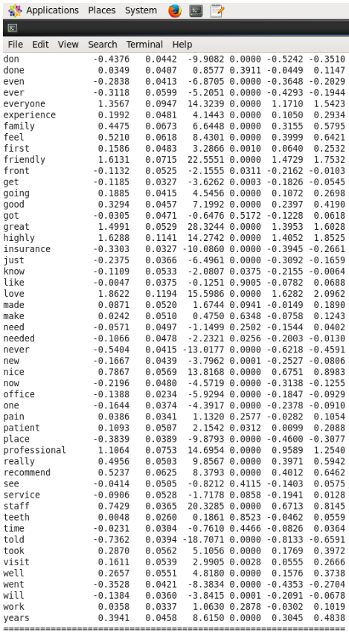
Prediction Model
Summary of the coefficient and significance
The frequencies of “amazing”, “best”, “everyone:, “comfortable”, “friendly”, “great“, “highly”, “love”, “professional” have a significant positive relationship with the positive review
The frequencies of “ever”, “insurance”, “never”, “just”, “even”, “ever”, “place”, “went” have a significant negative relationship with the positive review

Slide 17
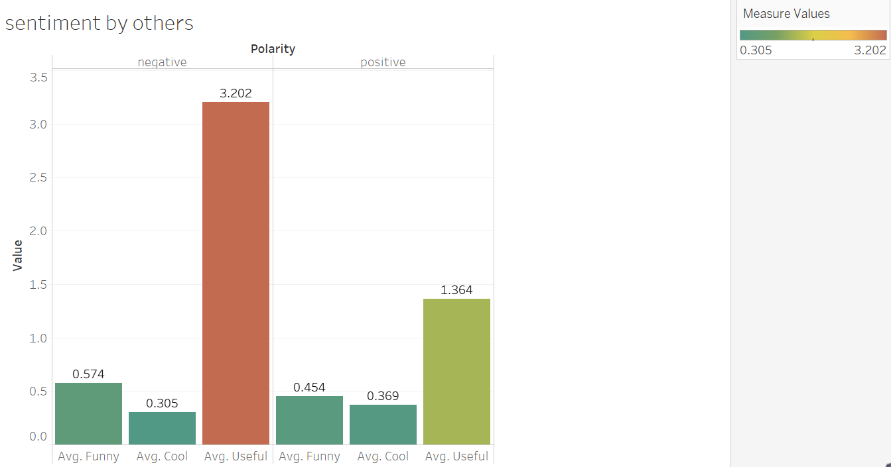
Interesting Findings
Customer tends to find negative review are more useful than positive review.
Generally, Customer do not personal favor too much on the attitude of the reviews.
8

Slide 18
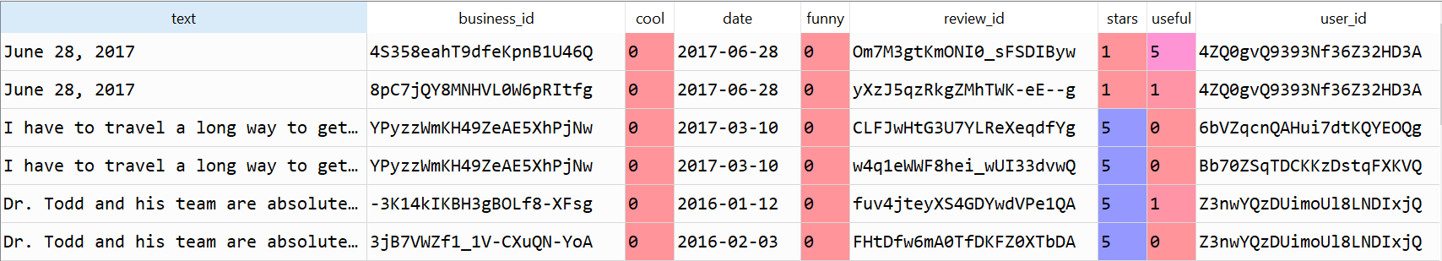
Interesting findings
9

Slide 19



Q&A
THANK YOU

